Slide 1
MMX
A company for booking car

Slide 2
Group Member
NG SHU LING
D190038A
Ilevarasar
D190019A
Jackson Ang
D190104B
LeowHongKai
EP180043C

Slide 3
Introduction
Our project is a car rental system to easier customers to rent a car. According to the needs and preferences of our customers, we offer a variety of car brands, types of cars (such as small, medium and large), manual and automatic gear to meet customer requirements.

Slide 4
Purpose for company
In order to easier customers to rent their ideal car more quickly, some customers need a full day of car, but if you use the grab, you will have to wait 10-15 minutes each time to wait for their grab to arrive.

Slide 5


TYPE OF CAR

Slide 6


TYPE OF CAR

Slide 7


TYPE OF CAR

Slide 8


TYPE OF CAR

Slide 9


TYPE OF CAR

Slide 10


TYPE OF CAR

Slide 11
Function of system
Can booking many type of car.
Can choose Auto or Manual .
Can choose payment Credit card or Online banking.
Can find driver to drive car.

Slide 12
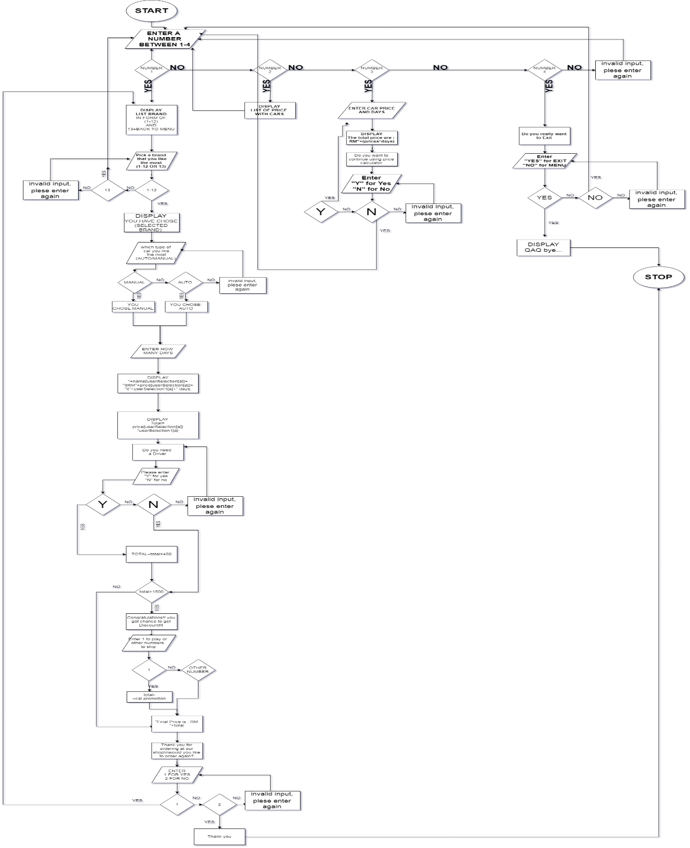
Algorithm(Flowchart)

Slide 13
Algorithm(Pseudocode)
1) Start
2) Enter a number between 1-4
3) If 1, print list of brand in form of 1 -12 and 13-back to menu
4) Enter a number between 1-13, if 13 repeat from start,
If 1-12 , print "you choose(selected number)"
Else, print " invalid input ,please enter again " and repeat
5)print which type of car you like the most(auto/manual)
6) Enter auto or manual. Else print " invalid input ,please enter again " and repeat

Slide 14
Algorithm(Pseudocode)
7) Enter how many days
8) print " name (userselection)+ Rm price(userselection) + userselection +"days"
9) print "Total = price×days"
10) enter y for yes N for no ,if you need a driver
11) if,yes add total =total+rm450
12) if total>1500,print " congratulation you got a chance to get Discount!!!"
13)Enter 1 to play or other number to skip
14)if,1 total-discount

Slide 15
Algorithm(Pseudocode)
15)print " Final price is: Rm "+total
16) print" thanks for ordering at our shop would you like to order again"
17) Enter 1 for yes,and 2 for no
18) if 1,repeat else print "thanks" and stop
19) if 2,print the list of car with their price
20) if 3, Enter car price and days
21) print " the total price is : " +(price× days)
22) print "do you want to continue using price calculator
23) Enter "Y" for yes and "No" for no

Slide 16
Algorithm(Pseudocode)
24)If Y, repeat
25) If N , back to menu, Else,print invalid input, please enter again
26) if 4,print do you really want to exit
27) Enter "yes" for exit and "No" for menu
27) If no , back to menu
29) If yes , STOP else print "invalid input, please enter again " and repeat
30) Else, print "invalid input, please enter again " and back to menu

Slide 17
Output
of
java

Slide 18
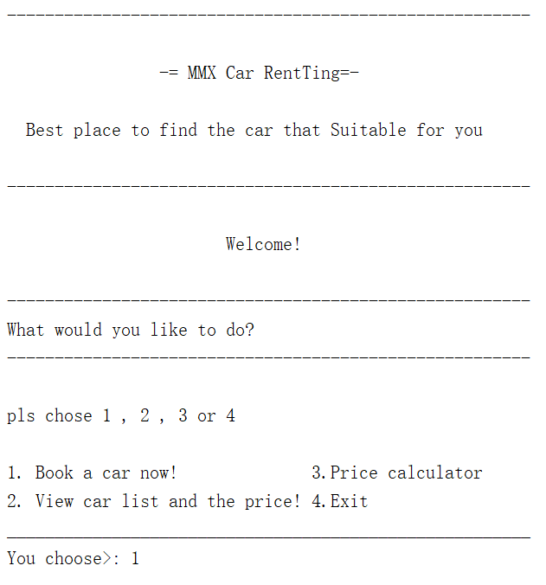

Slide 19
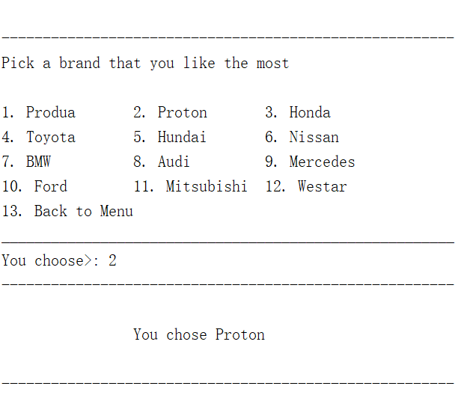

Slide 20
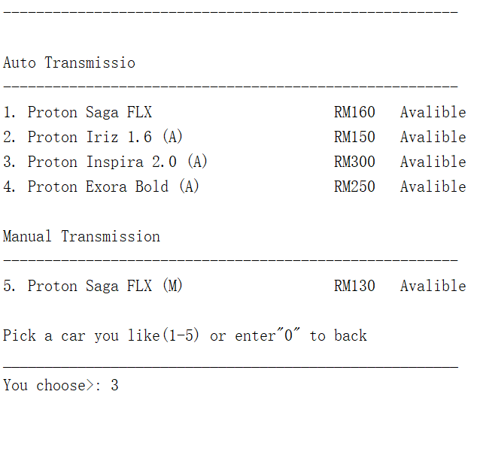

Slide 21
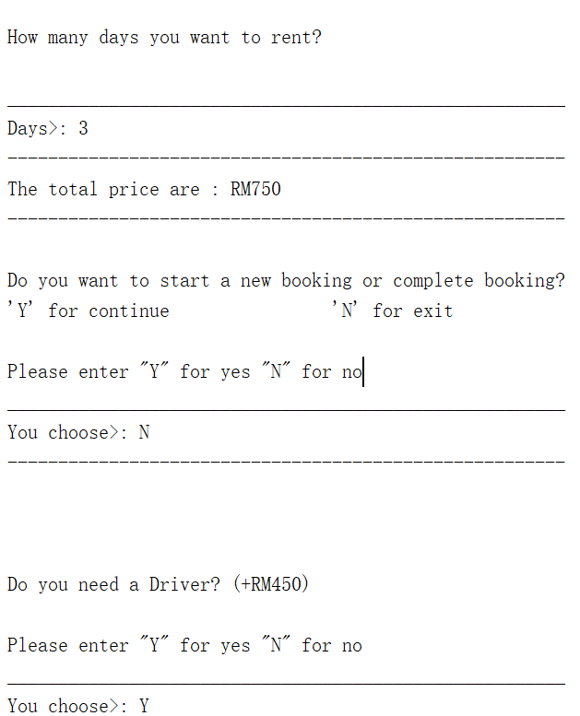

Slide 22
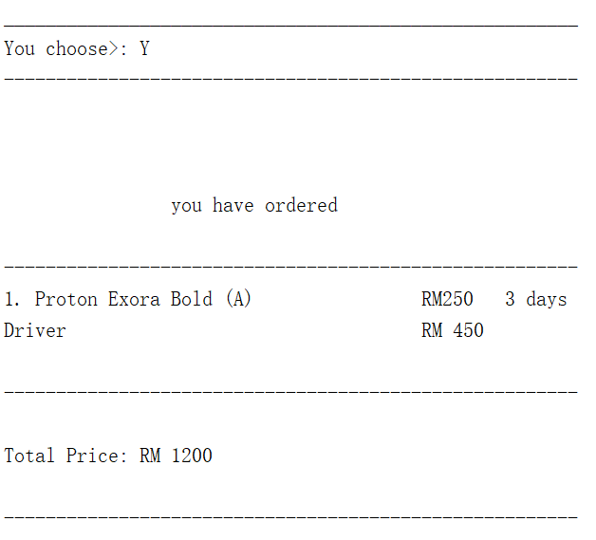

Slide 23
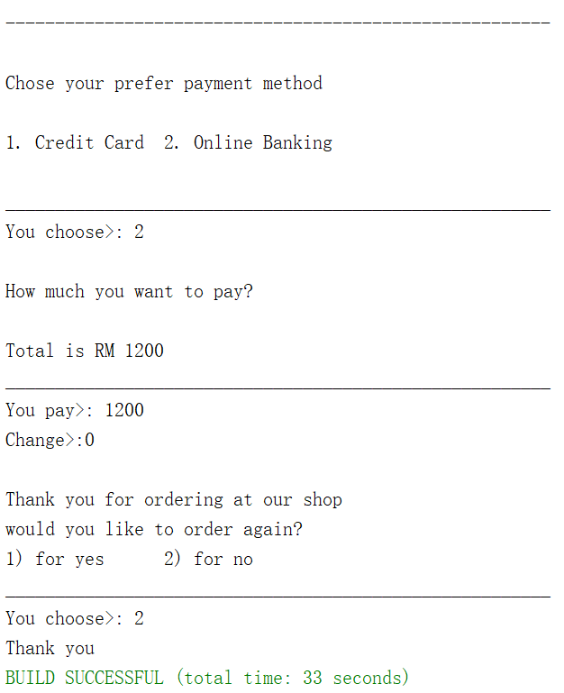

Slide 24
That's all~
Thank you

